Slide 1
CAR INVENTORY MANAGEMENT SYSTEM
Afran Davalbhai (2AG19CS002)
Afnan Hudli (2AG19CS001)
Under the guidance of
Prof. Pooja Kullinavar

Slide 2
Agenda
Introduction
Primary goals
Areas of growth
Timeline
Summary

Slide 3
Abstract
The main aim of this CAR INVENTORY MANAGEMENT SYSTEM mini project is to keep the track of employees, suppliers, sales, purchases & bills of car spare products. We aim to demonstrate to use create, read, update and delete SQL operations through this project. The project is built for the owner of a wholesale car spares store who is able to keep track of employees, sales & the suppliers of different categories of products. The project starts by entering login details of the type of user into the database. It has 2 kinds of login authentication, that is Admin & Employee. The logic is designed in such kind that if the user account is of Admin then it redirects the user to the dashboard page. And if the user is an Employee, then it redirects to the billing page. The Admin has all the privileges to enter the details of an employee, add and delete the suppliers, manage the products and also view the bills. The employee has the privileges of generating the bills. The employee can add the products into the bill, generate and also print the bills. The employees, suppliers and the products can be further modified which demonstrates the update functionality. We can also search for employees, suppliers and the products based on their respective attributes. Finally, we can view the count of all the entities directly on the application dashboard. The application is built using Python Tkinter Framework and SQLite 3 technologies.

Slide 4
Introduction
With tremendous increase in technology, information technology is a fast-developing field. Technology which is in vogue today might become redundant tomorrow. This ever-changing scenario makes it possible to provide the latest and most modern IT solutions to various business and institutions.
We are doing our project on Car Inventory Database Management. There is the need for efficient management-based system for handling all details about suppliers, products and customers.
This project is an endeavor to provide a solution to this. The proposed system enables an administrator to keep track of all the information and maintaining records of the different categories of products, available with the suppliers and the customers who purchase our products. The Admin has all the privileges to enter the details of an employee, add and delete the suppliers, manage the products and also view the bills. The employee has the privileges of generating the bills. The employee can add the products into the bill, generate and also print the bills.
Thus, the project is a sincere effort in simplifying the task of administrators & employees in an easily usable format.
Me and my partner Afnan are fond of cars and one evening we were passing by a car showroom and that time we got the idea for this project,so we finalized to make this project and hence planned to develop this system using PyCharm for front end and SQL as the Back End.

Slide 5
System Analysis
EXISTING SYSTEM
Before starting the project we have to study its present and objective some of them are:-
All the processes of this management were done manually in the form of paper work and the records were stored in the registers. In such cases there were frequent chances of data redundancy and data is ease to lose.
All the introductions related to the products and others were printed on the papers, and this activity may lead to losing the data accidently.
All the record structures are done by hand written; sometimes it produces mistakes in calculation.
This system is very time consuming and require lots of manpower
PROPOSED SYSTEM
Objective is to overcome the major limitation of the existing enabling effective management of the products, sales, employee details and customer details thereby improving the performance.
With improved computerization being involved in the maintenance of all the details, can be kept at par.
Easy retrieval of data will be made possible by finding techniques.
Validation of data will ensure only accurate, valid and complete data is stored in the database.
Also focused on UI which provides user friendly, clean and easy to use application which enhances overall user experience.
This will be much less time-consuming comparing to existing system.

Slide 6
System Requirements
Hardware Requirements
Software requirements
• Processor-i3, i5
• Hard Disk -25GB Minimum
• RAM-1GB Minimum
Windows 10
• Front End: PyCharm
• Back End: SQLite 3
Language used
• PYTHON
• SQL

Slide 7
Methodology
A method in python is somewhat similar to a function, except it is associated with object/classes. Methods in python are very similar to functions except for two major differences.
• The method is implicitly used for an object for which it is called.
• The method is accessible to data that is contained within the class.
SQLite3 can be integrated with Python using sqlite3 module, which was written by Gerhard Haring. It provides an SQL interface compliant with the DB-API 2.0 specification described by PEP 249. You do not need to install this
sqlite3.connect()
A connection with the SQL server can be established using either the sqlite3.connect() function

Slide 8
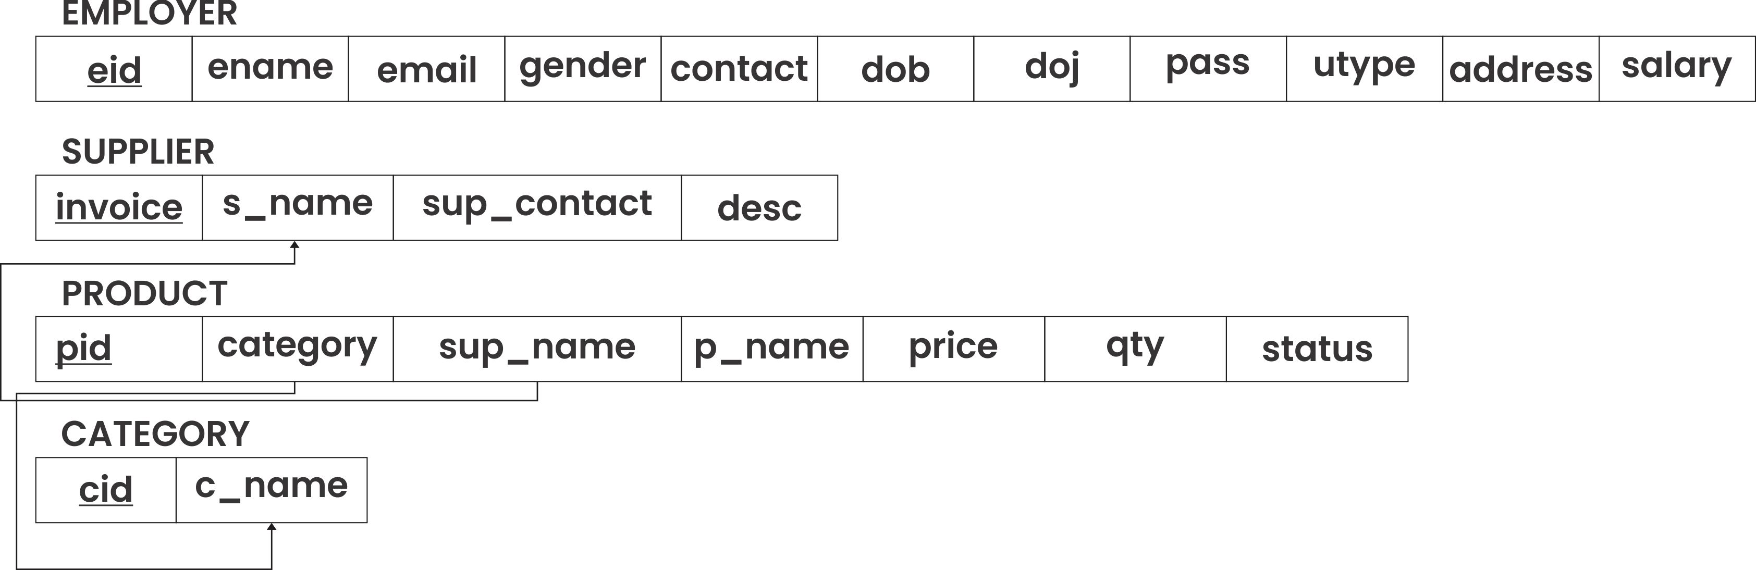
Schema Diagram

Slide 9
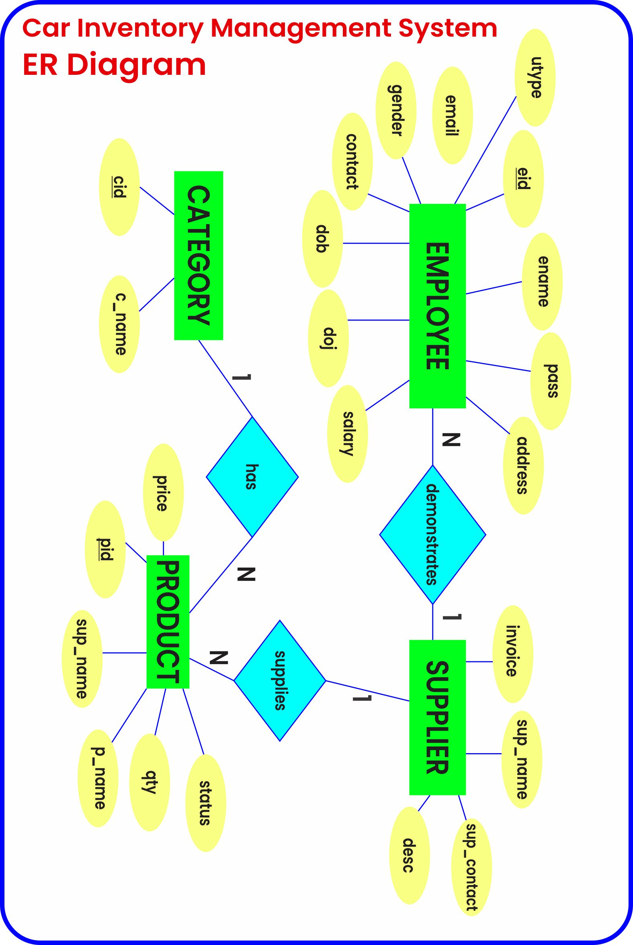
Entity-Relationship Diagram

Slide 10
Primary goals
Annual revenue growth

Slide 11
Quarterly performance

Slide 12
Areas of growth
 | B2B | Supply chain | ROI | E-commerce
Q1 | 4.5 | 2.3 | 1.7 | 5.0
Q2 | 3.2 | 5.1 | 4.4 | 3.0
Q3 | 2.1 | 1.7 | 2.5 | 2.8
Q4 | 4.5 | 2.2 | 1.7 | 7.0

Slide 13
Business opportunities are like buses. There's always another one coming.
“
”
Richard Branson

Slide 14




Meet our team
Takuma Hayashi
Mirjam Nilsson
President
Chief Executive Officer
Flora Berggren
Rajesh Santoshi
Chief Operation Officer
VP Marketing

Slide 15








The full team
Takuma Hayashi
Mirjam Nilsson
Flora Berggren
Rajesh Santoshi
President
Chief Executive Officer
Chief Operations Manager
VP Marketing
Graham Barnes
Rowan Murphy
Elizabeth Moore
Robin Kline
VP Product
SEO Strategist
Product Designer
Content Developer

Slide 16
Plan for product launch
Deploy strategic networks with compelling e-business needs
Planning
Synergize scalable e-commerce
Marketing
Disseminate standardized metrics
Design
Coordinate
Foster holistically superior methodologies
Launch
Strategy
e-business applications
1
2
3
4
5

Slide 17
Timeline
Deploy strategic networks with compelling e-business needs
Sep 20XX
Synergize scalable e-commerce
Nov 20XX
Disseminate standardized metrics
Jan 20XX
Coordinate e-business applications
March 20XX
Foster holistically superior methodologies
May 20XX

Slide 18
Areas of focus
B2B market scenarios
Cloud-based opportunities
Develop winning strategies to keep ahead of the competition
Capitalize on low-hanging fruit to identify a ballpark value
Visualize customer directed convergence
Iterative approaches to corporate strategy
Establish a management framework from the inside

Slide 19
How we get there
ROI
Niche Markets
Supply chains
Envision multimedia-based expertise and cross-media growth strategies
Visualize quality intellectual capital
Engage worldwide methodologies with web-enabled technologies
Pursue scalable customer service through sustainable strategies
Engage top-line web services with cutting-edge deliverables
Cultivate one-to-one customer service with robust ideas
Maximize timely deliverables for real-time schemas

Slide 20
Summary
At Contoso, we believe in giving 110%. By using our next-generation data architecture, we help organizations virtually manage agile workflows. We thrive because of our market knowledge and great team behind our product. As our CEO says, "Efficiencies will come from proactively transforming how we do business."

Slide 21
Thank you
Mirjam Nilsson​
mirjam@contoso.com
www.contoso.com

